Slide 1
Module 0: Intro and Alignment
NC State scRNA Workshop, 2024

Slide 2


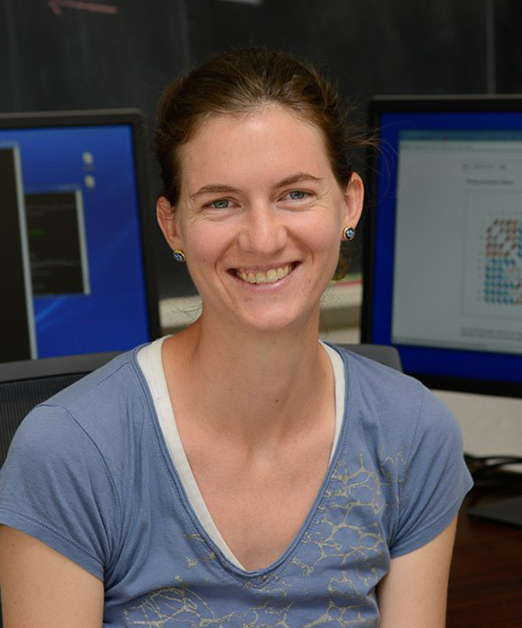

Meet your Instructors
Bruce Corliss, PhD
Research Bioinformatician at NC State
Support for Dr. Fred Wright (BRC),
Dr. Cathrine Hoyo (Biological Sciences), and the
Center for Human Health and the Environment
Allison Dickey, PhD
Research Associate at NC State
Bioinformatics Consulting & Service Core

Slide 3
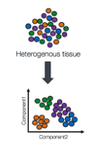
Learning Objectives
Overarching Purpose: to discuss the basics of processing and interpreting scRNA-Seq Data. Participants will learn new analysis techniques through technical summaries and gain an understanding of the workflow from this workshop.
Understand the basic process of how single cell RNA-seq is analyzed.
Familiarity with standard processing pipeline with Seurat.
Intuitive understanding of the need and concept for each part of the pipeline.
Perform basic cell type labelling.
What does this workshop not cover?
How to experimentally confirm your single cell results following the standard of practice for your subfield.
How to generate high fidelity cell type labels (can take months/ years of effort).
A mathematical understanding of the processing pipeline.
How to tailor these standard concepts to your specific research needs.

Slide 4

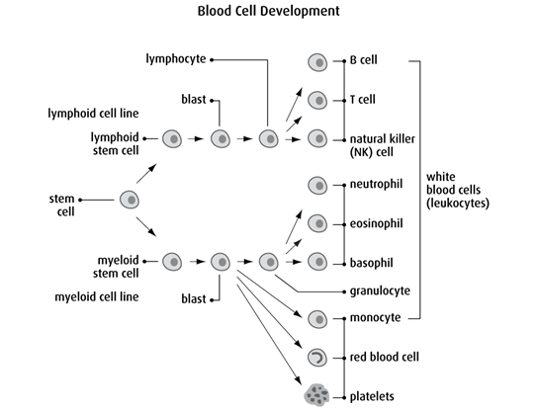
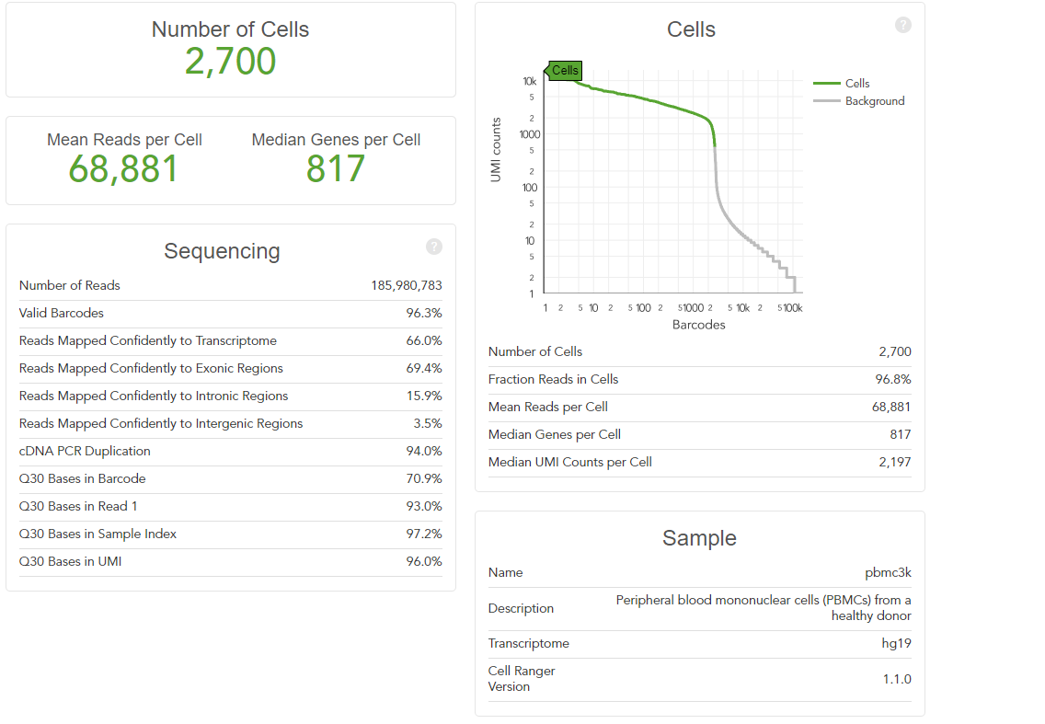
The Teaching Dataset
Peripheral blood mononuclear cells (PBMCs) from a healthy donor
Used for all powerpoints and the test_pipeline.R script.
Artificially altered for Dataset Integration, Differential Gene Expression, and Cell Trajectory/ Pseudotime Analysis to illustrate the null case.
https://cf.10xgenomics.com/samples/cell-exp/1.1.0/pbmc3k/pbmc3k_web_summary.html
https://cancer.ca/en/cancer-information/what-is-cancer/blood-and-bone-marrow

Slide 5
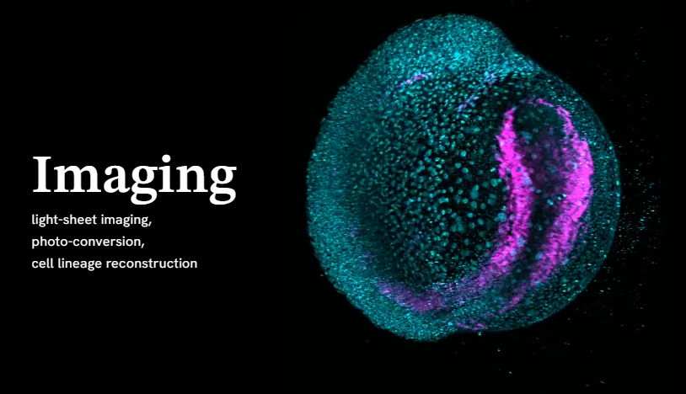
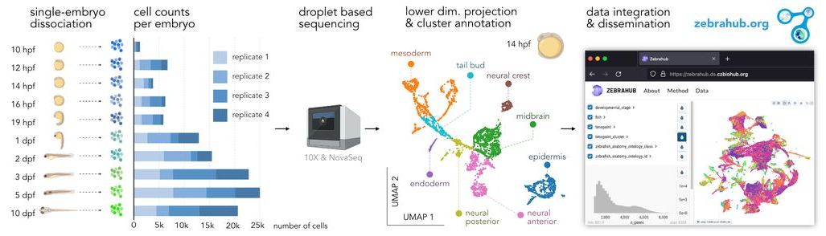
The Interactive Dataset
Zebrahub is a comprehensive atlas of zebrafish embryonic development.
Technologies: single-cell RNA sequencing and live light-sheet imaging.
Provides a complete cartography of cellular lineages in space, time, and molecular domains, an essential step toward understanding how organisms develop.
Zebrahub - Multimodal Zebrafish Developmental Atlas Reveals the State Transition Dynamics of Late Vertebrate Pluripotent Axial Progenitors. Lange et al. BioRxiv 2023.

Slide 6
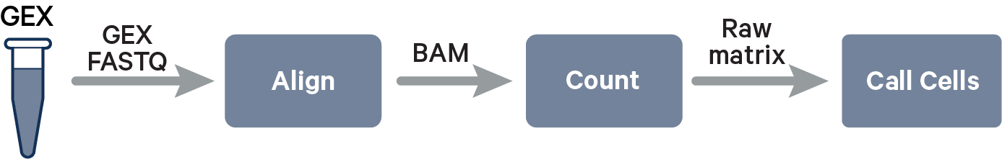
Single Cell Alignment with Cell Ranger
Reference Genome
Cell Ranger takes these input reads and produces counts for gene expression counts.
https://www.biosyn.com/faq/What-Is-A-Template-Switching-Oligonucleotide.aspx
https://www.10xgenomics.com/support/software/cell-ranger/algorithms-overview/cr-gex-algorithm

Slide 7
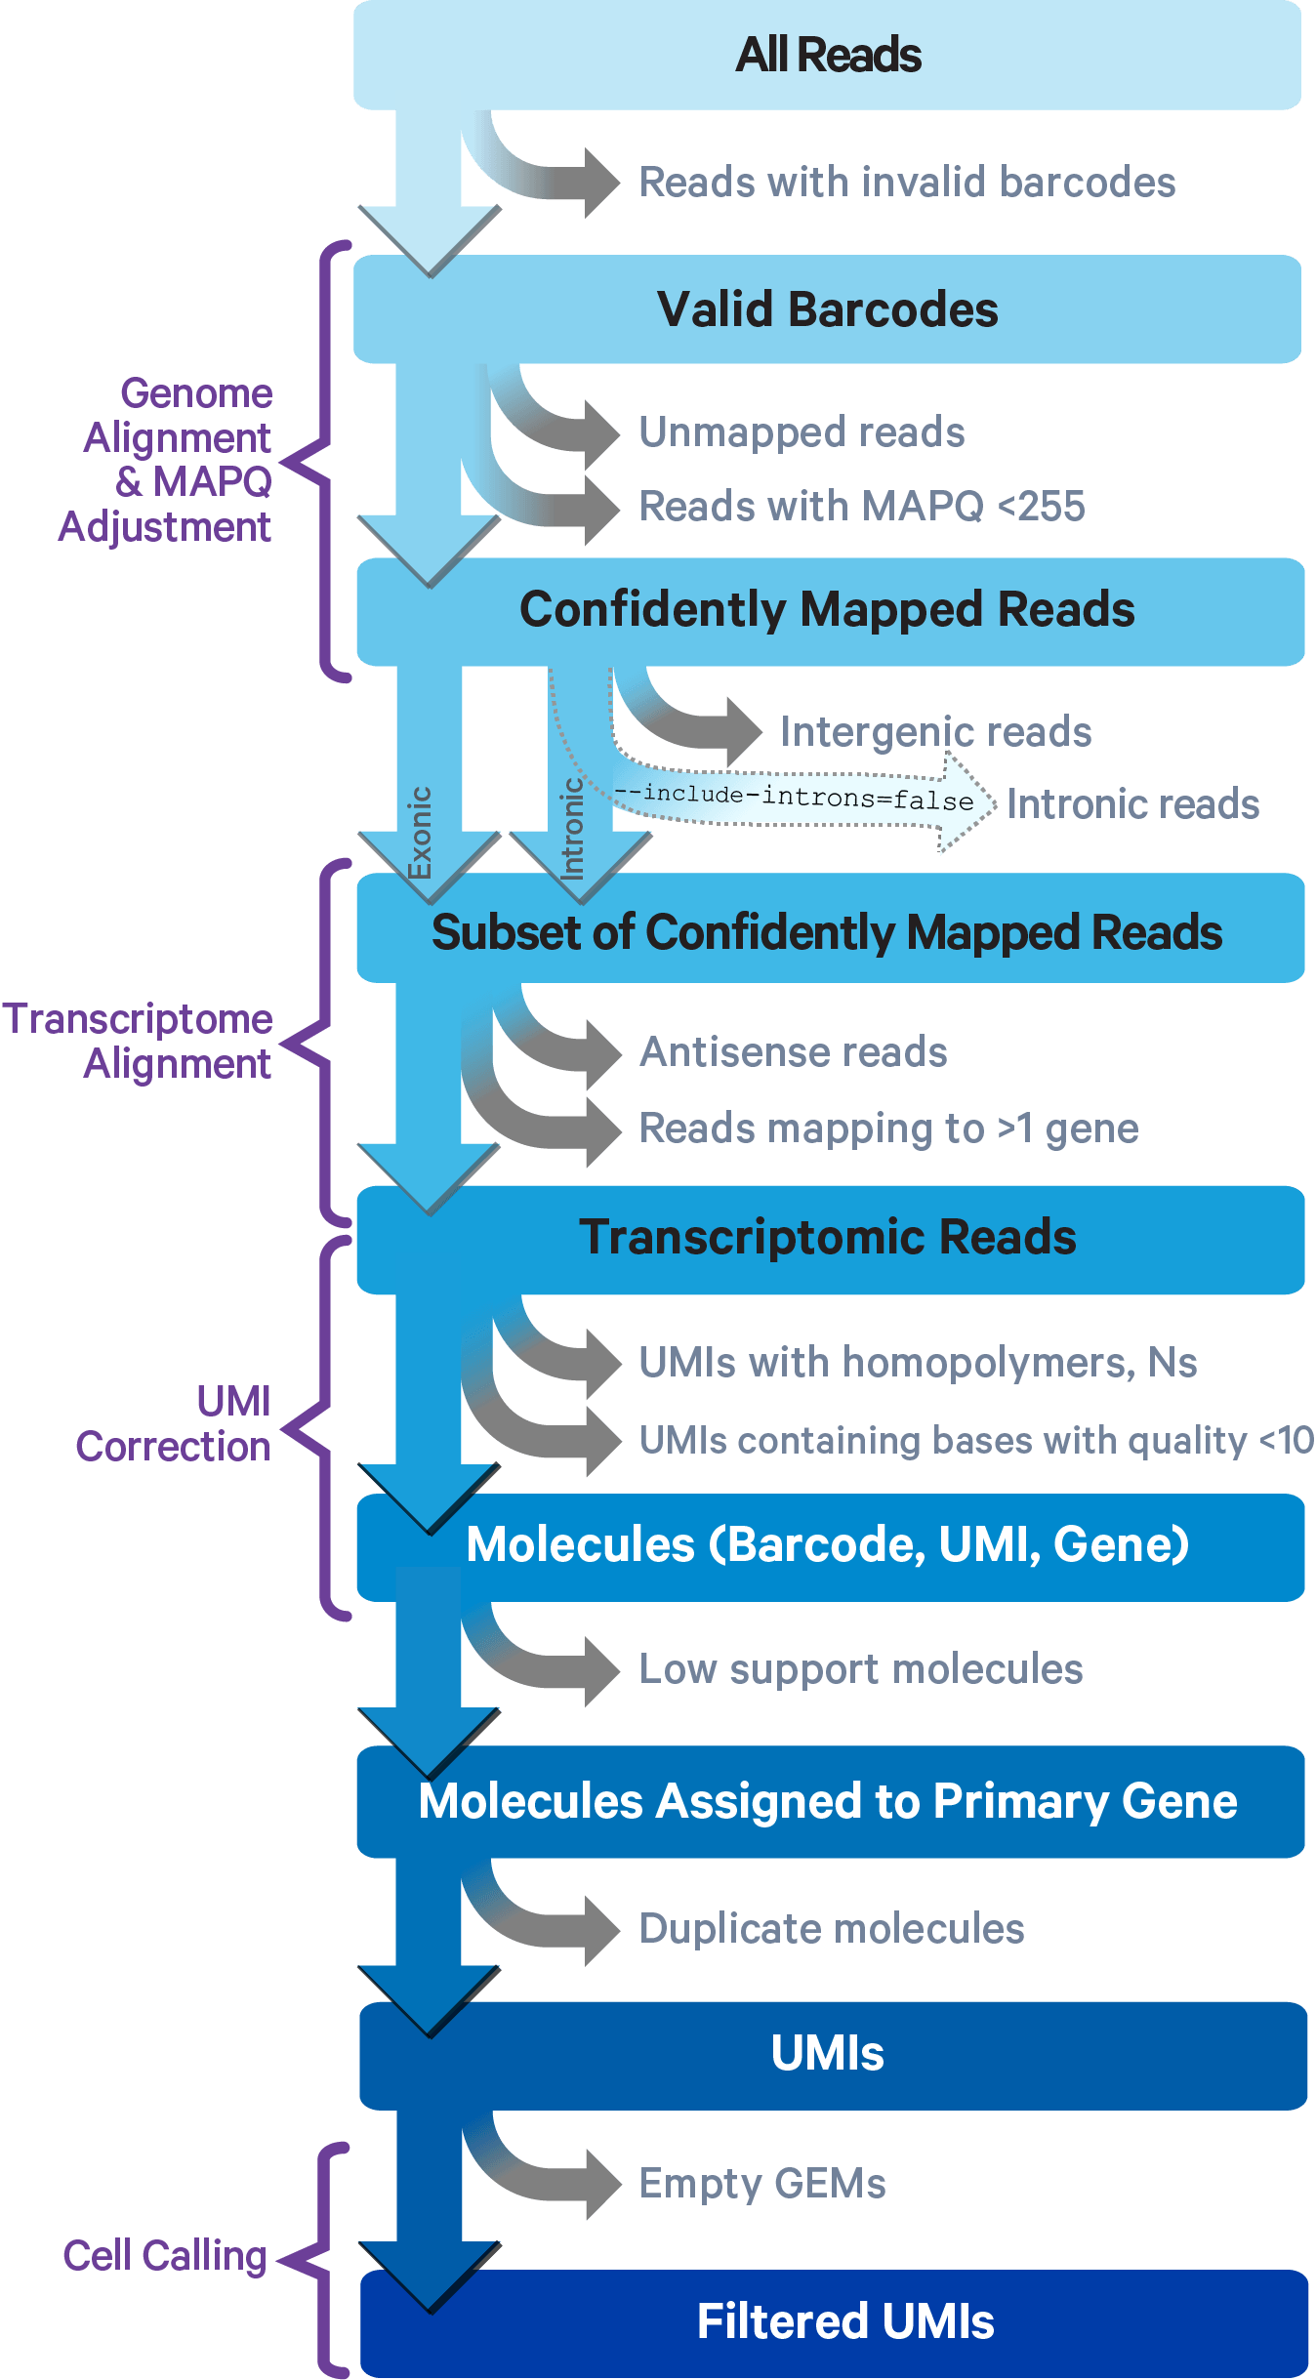


Cell Ranger Alignment: 1 - 2
1
1. Cell Ranger compares 10x barcodes to the whitelist file of known barcodes for a given assay.
2
Whitelist
3
3’
5’
3’
5’
3’
5’
3’
5’
3’
5’
3’
5’
3’
5’
~
3’
5’
4
3’
5’
~
3’
5’
3’
5’
~
3’
5’
3’
5’
~
3’
5’
3’
5’
x
3’
5’
5
3’
5’
x
3’
5’
3’
5’
x
3’
5’
6
Barcodes that don’t match any whitelist entries are statistically tested if there is sufficient evidence that they have a sequencing error and are an actual match.
If so, bar code is corrected to the closest matching entry and included, nonmatching barcodes are discarded.
7
8
9
https://www.10xgenomics.com/support/software/cell-ranger/algorithms-overview/cr-gex-algorithm

Slide 8
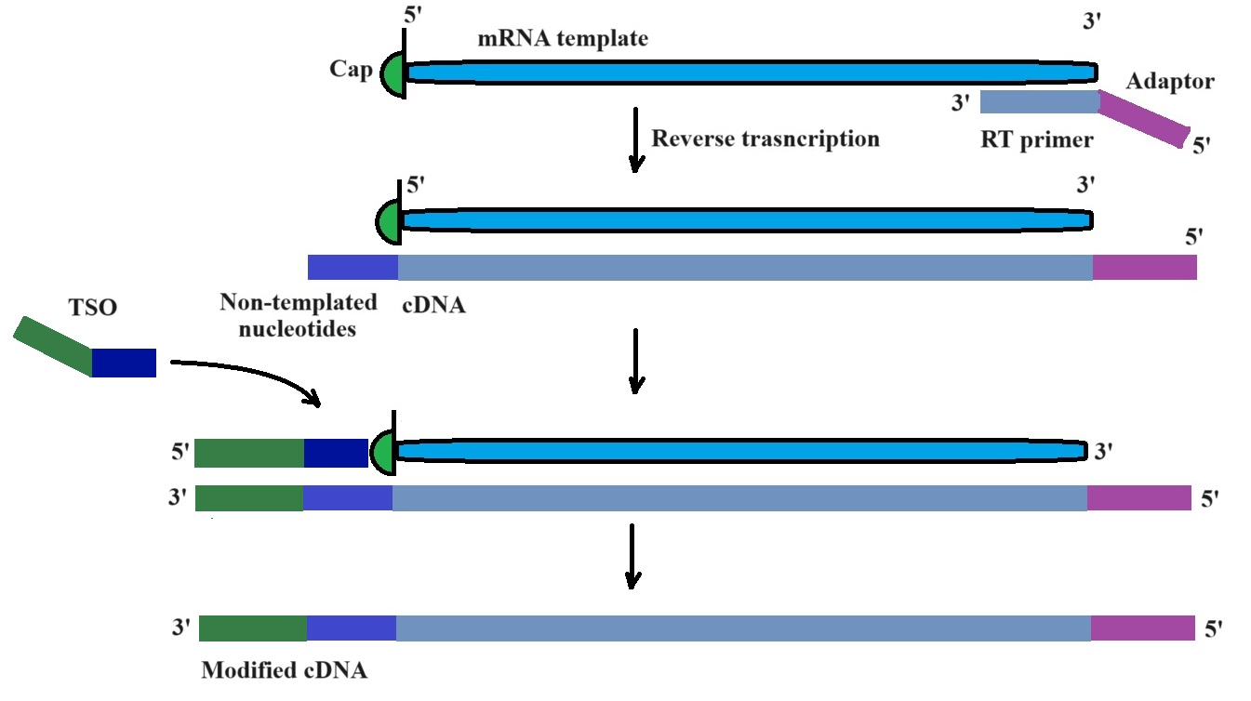
Cell Ranger Alignment: 1 - 2
1
2
3
2. Read trimming: the 3’ switch oligo sequence and 5’ poly-A tail are trimmed from reads in cDNA library prior to alignment.
4
Full length cDNA Reads
Trimmed cDNA Reads
5
6
7
8
9
https://www.10xgenomics.com/support/software/cell-ranger/algorithms-overview/cr-gex-algorithm

Slide 9
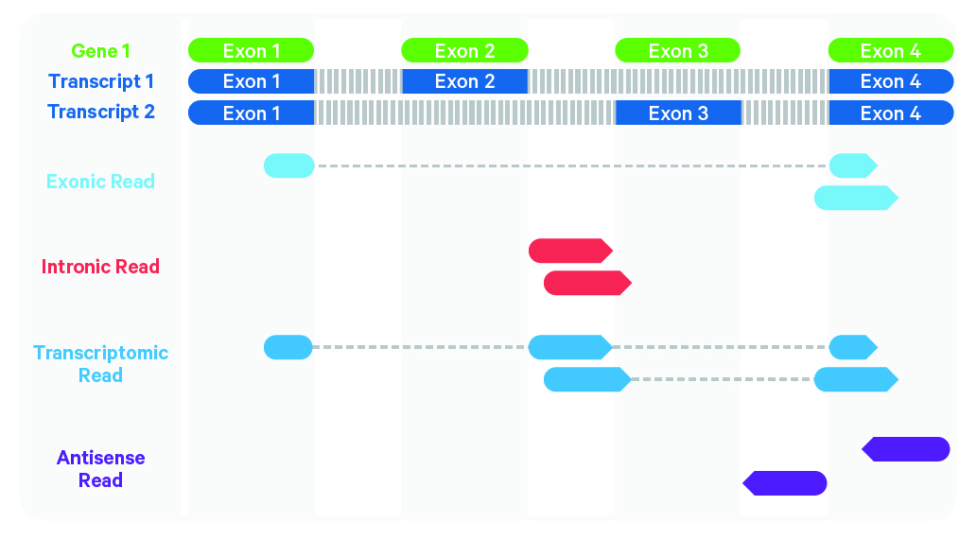
Cell Ranger Alignment: 3 - 4
1
Cell Ranger uses the STAR aligner, which perform splicing-aware alignment of reads to the genome.
2
3
Reference
Genome
4
5
Experiment
Reads
6
7
Antisense reads are discarded because they are not part of the transcriptome.
8
Exonic reads as well as Intronic reads that are mapped to a single gene are kept (intronic maximizes sensitivity even though it is not included in the mature RNA strand).
9
https://www.10xgenomics.com/support/software/cell-ranger/algorithms-overview/cr-gex-algorithm

Slide 10
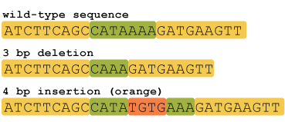
Cell Ranger Alignment: 5 - 6
1
5. Cell Ranger Discards Low Quality Reads
Quality = mapping to a specific genome location with high confidence.
Must not contain bases with base quality < 10
Must not contain N
Must not be a homopolymer, e.g. AAAAAAAAAA
2
3
Homopolymer reads (2+ repeat bases): known to be sources of error for DNA sequencing because it’s difficult to distinguish number of repeats beyond 2 (leads to alignment errors for the rest of reads.
1.43 million homopolymer regions in human genome.
4
5
6
6. Cell Ranger performs Umi counting
Reads are grouped by barcode, UMI, and gene annotation
If there are reads with same barcode and UMI but different gene annotations, discards the annotation with least supported reads (low support molecules).
7
8
Output counts: unfiltered featured-barcode matrix
9
https://www.10xgenomics.com/support/software/cell-ranger/algorithms-overview/cr-gex-algorithm
https://hackbrightacademy.com/blog/indel-finder-how-the-python-version-of-this-program-works/

Slide 11
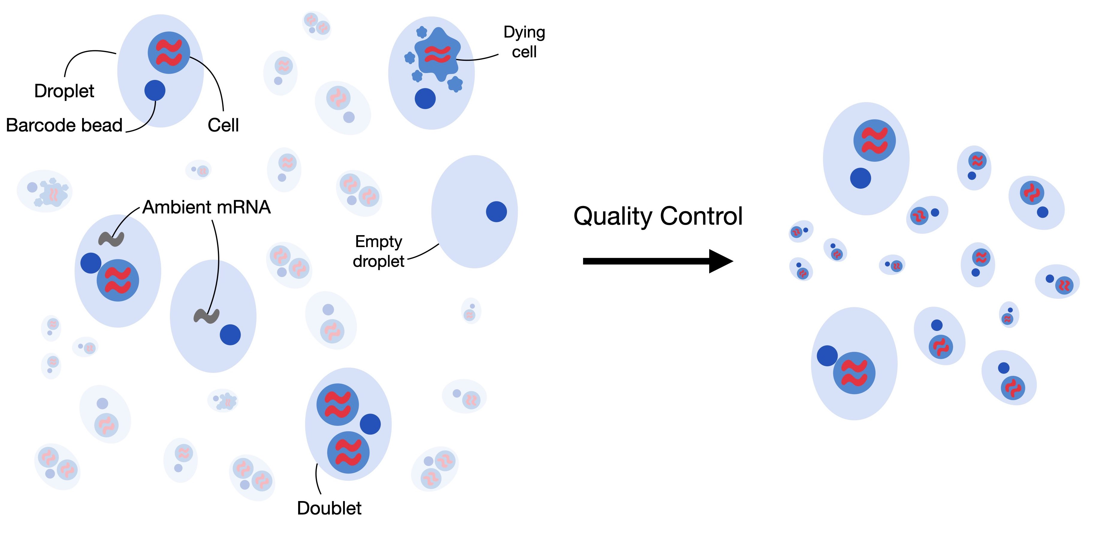
Cell Ranger Alignment: 7 - 9
1
7. In addition to 6 for the groups of reads with the same barcode and UMI, if there is the same level of read support for more than one gene annotation, a gene cannot be confidently assigned and the read groups will be discarded.
2
3
4
8. Discard Empty GEMs (gel bead in emulsion droplets).
5
6
7
8
>> Output results: filtered featured-barcode matrix
9
https://www.10xgenomics.com/support/software/cell-ranger/algorithms-overview/cr-gex-algorithm

Slide 12
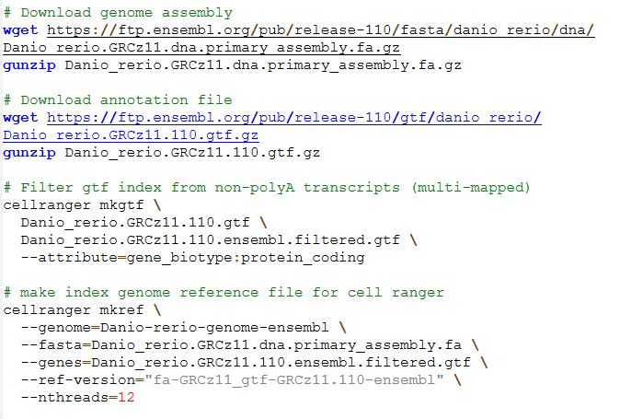
Cell Ranger Indexed Reference Genome Script

Slide 13
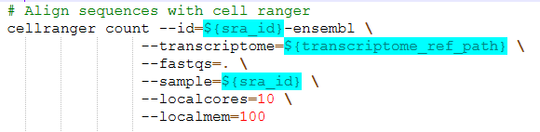
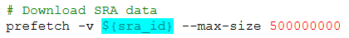
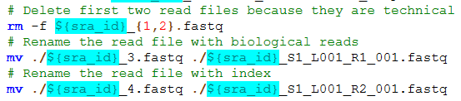
Cell Ranger Alignment Script
Example script found in /M2_CellRanger_Alignment/align_zebrahub_sra.sh
./SRR23691690
./SRR23691690_1.fastq
./SRR23691690_2.fastq
./SRR23691690_3.fastq
./SRR23691690_4.fastq
./SRR23691690_S1_L001_R1_001.fastq
./SRR23691690_S1_L001_R2_001.fastq
https://www.10xgenomics.com/support/software/cell-ranger/algorithms-overview/cr-gex-algorithm

Slide 14
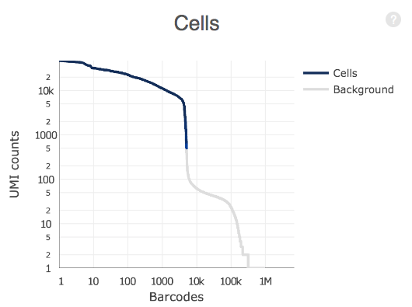
Cell Ranger Outputs
>> matrix.mtx
>> features.tsv
>> barcodes.tsv
Unfiltered featured-barcode matrix: raw gene-barcode matrix includes all valid barcodes from GEMs (Gel Bead-In EMulsions) captured in the data. However, because most GEMs do not actually contain cells, it follows that most barcodes in the data do not correspond to cells, but rather background noise (e.g. GEMs with free-floating mRNA from lysed or dead cells).
Filtered featured-barcode matrix: The filtered gene-barcode matrix excludes barcodes that correspond to this background noise. This can be visualized in the barcode vs UMI count rank plot in the web summary file.
Notes:
In the example plot below, UMI counts are on the y-axis ranging from 0 to 10,000 in log scale. Barcodes are on the x-axis, ranked from 0 to 1,000,000 also in log scale. Cell-associated barcodes as determined by the cell-calling heuristic are in blue while background barcodes are in gray.

Slide 15
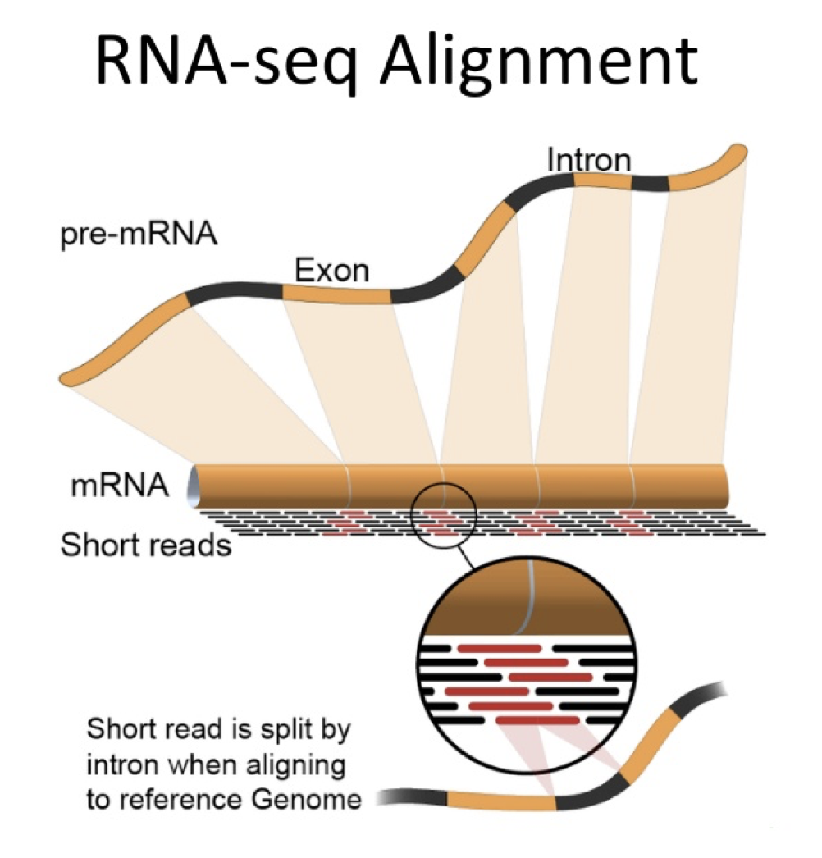
Questions?
1
2
3
4
5
6
7
8
https://bioinformatics.ccr.cancer.gov/docs/b4b/RNASeq_Overview/05.Alignment/
9

Slide 16
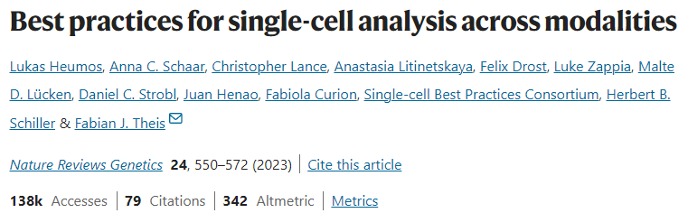
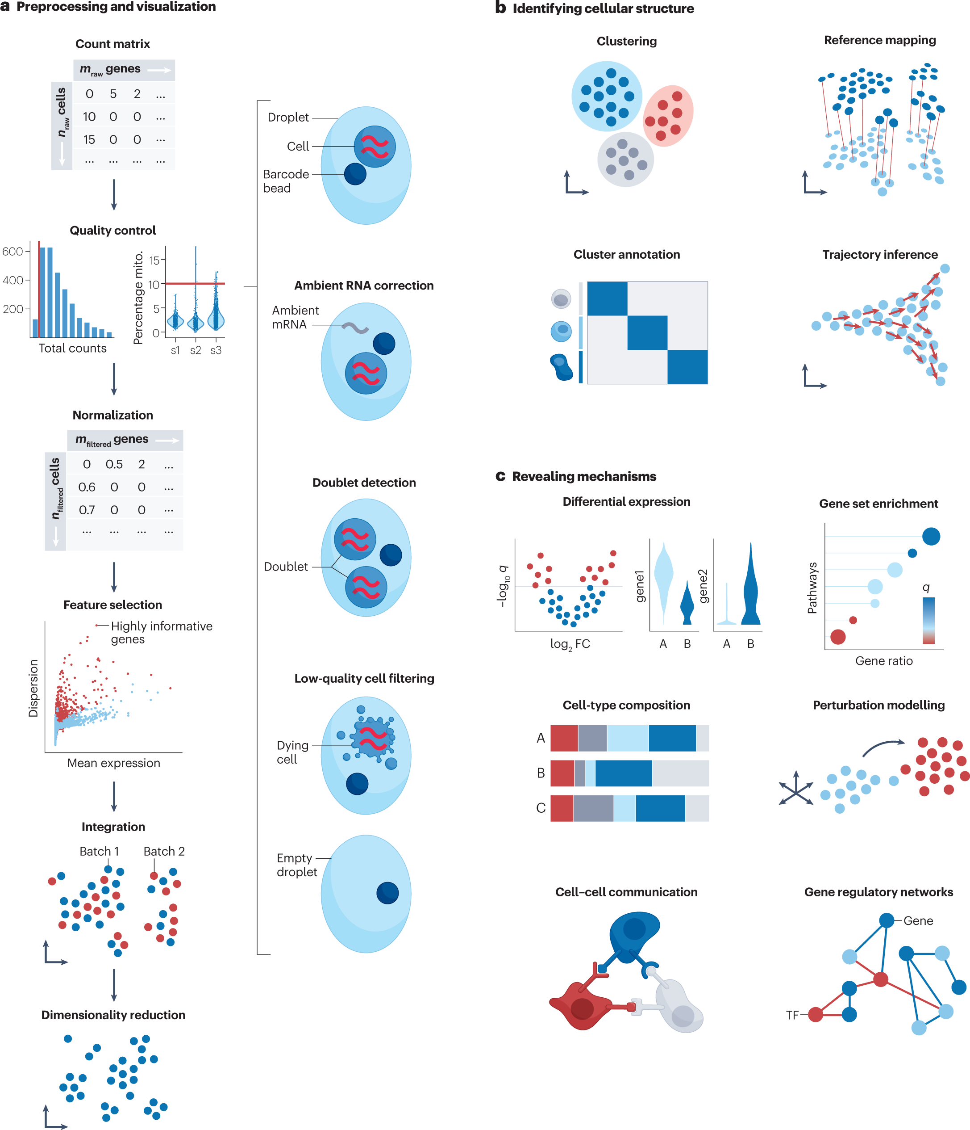
Post Class Assignment A

Slide 17
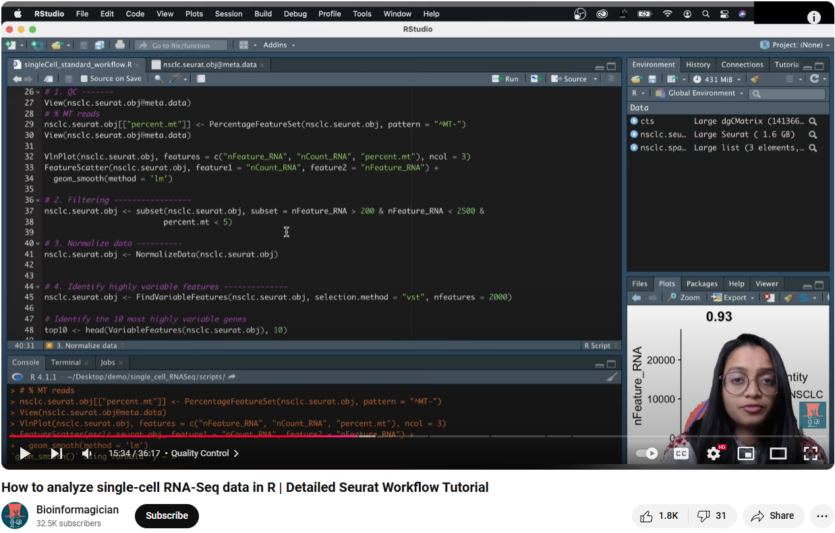
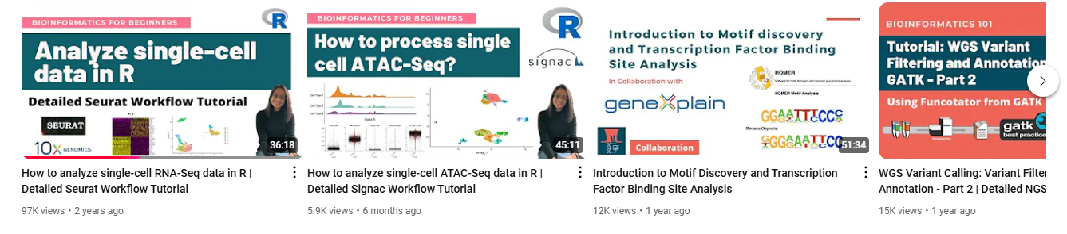
Post Class Assignment B
https://www.youtube.com/@Bioinformagician

Slide 18




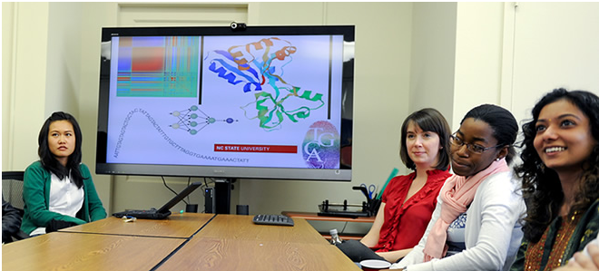
Bridging biological research and data science for the next generation of scientific discoveries.

